Slide 1
MERCER’S INDIVIDUAL HEALTH INSURANCE SOLUTIONS

Slide 2
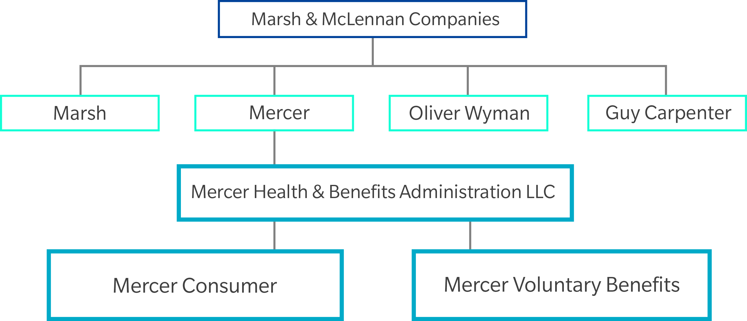
Mercer’s Individual Health Insurance Solutions Who We Are: Organizational Structure
Company Highlights
More than 75 years of experience
$2.5 billion in annual premium placed
Largest Private Client broker in the US
Largest Association Producer for insurers
Award-winning program communications
Superior track record for onboarding large, transaction-centric programs
More than 1,000 professionals across the US
Association Business Creates and manages programs for:
Affinity Groups
Unions
Professional Associations
Medical Professional Associations
Bar Associations
Alumni Associations
Military
Notes:
1

Slide 3
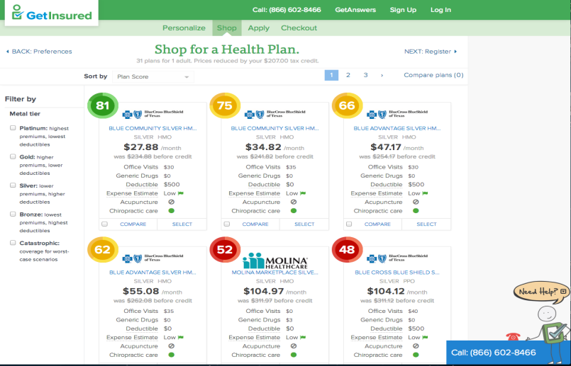

Mercer’s Individual Health Insurance Solutions What It Is
Stand-alone individual medical solution (on or off public exchanges)
Ideal for associations wanting to offer health insurance options for their membership
Online and call center support
Can be coupled with group sponsored voluntary benefits
Free and easy implementation with both online and telephone configuration available
Pre-enrollment and post-enrollment communication support

Slide 4
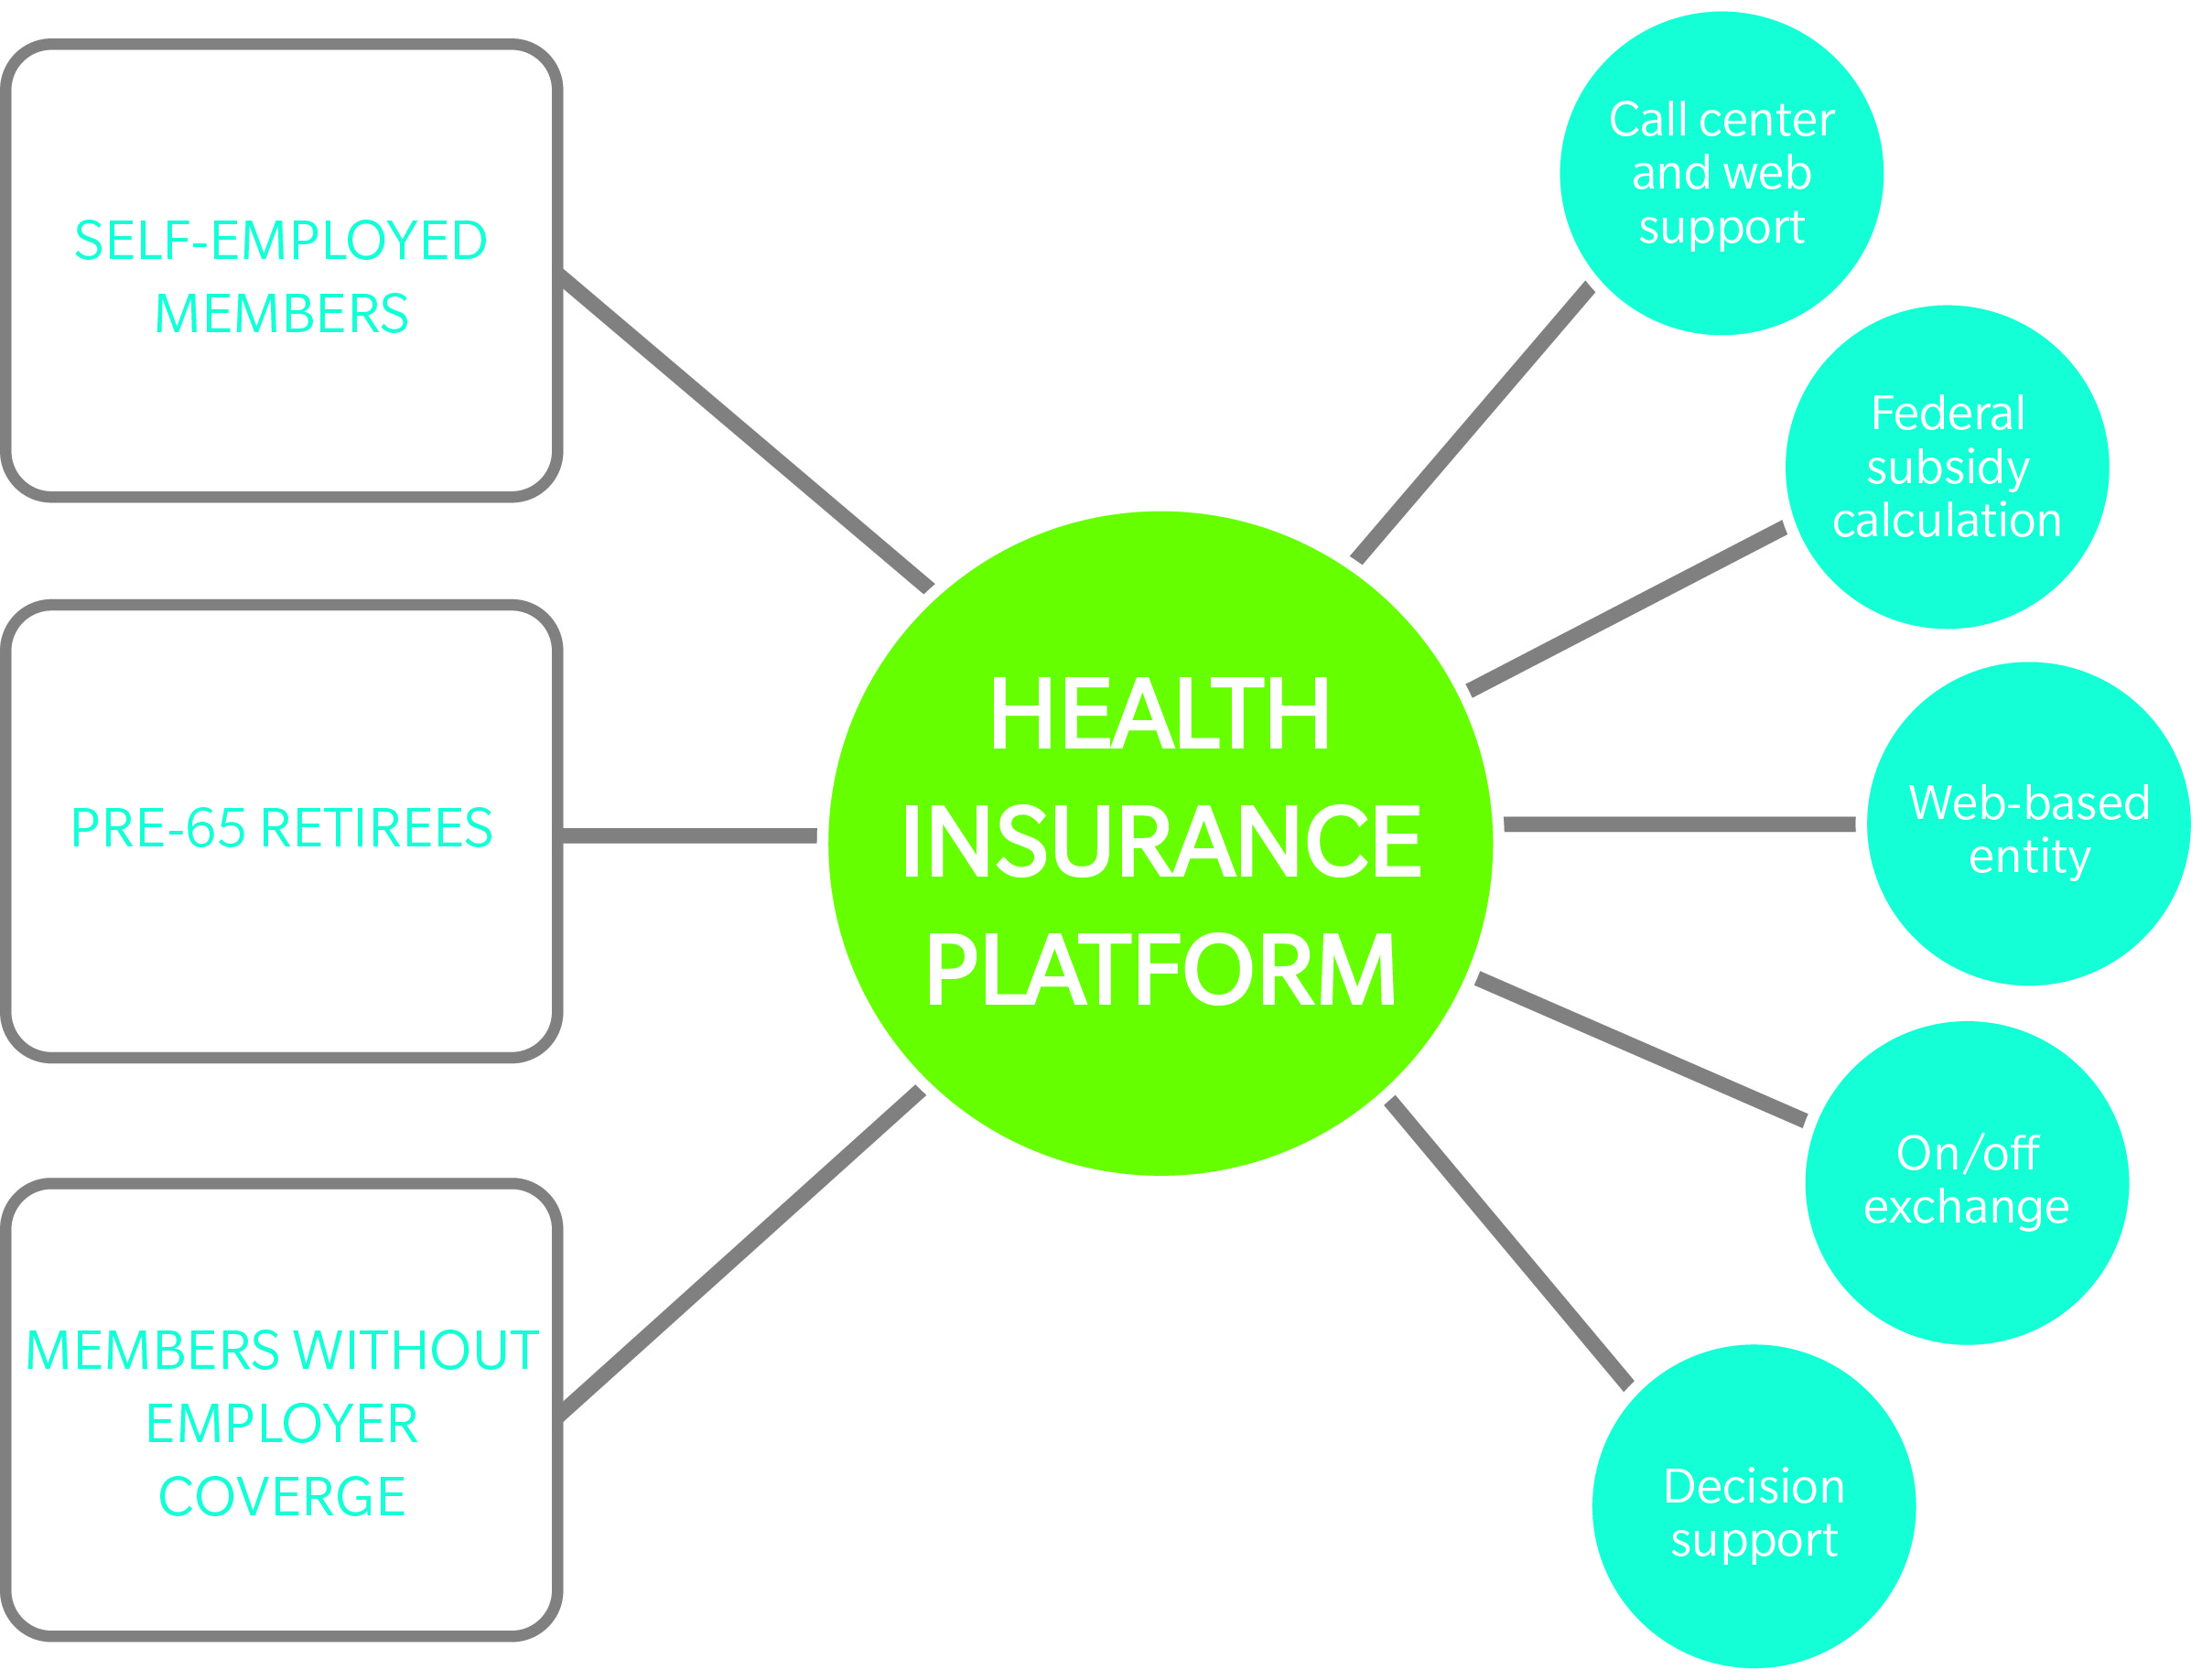
Mercer’s Individual Health Insurance Solutions Who It’s For

Slide 5
Mercer’s Individual Health Insurance Solutions The Need for Trusted Advisors: Educate, Assist, Enroll
50%
AMERICANS DO NOT KNOW ABOUT HEALTH CARE EXCHANGES
66%
AMERICANS QUALIFY FOR FEDERAL SUBSIDIES ON THE PUBLIC EXCHANGES
42%
AMERICANS DO NOT KNOW WHAT A DEDUCTIBLE IS
33%
AMERICANS DO NOT KNOW THAT FEDERAL SUBSIDIES ARE AVAILABLE
Preparedness of Americans for the Affordable Care Act, March 24, 2014

Slide 6
Mercer’s Individual Health Insurance Solutions Expert Help Online and Off
WEBSITE HIGHLIGHTS
User-friendly
Award-winning user interface, helpful tools and expert content
Innovative
GetInsured Plan ScoreTM — leading the way in personalization and decision support tools
Proven
Nearly a decade of experience building consumer, government and employer marketplaces
CONTACT CENTER HIGHLIGHTS
Accessible
Immediate, personalized guidance 16 hours a day, 7 days a week
Brand enhancing
Friendly, professional, knowledgeable — establish trust quickly
Trustworthy
Fully licensed brokers simplify the complexity of insurance
Co-browsing capabilities
Best-in-class service at their pace, on their terms

Slide 7
Mercer’s Individual Health Insurance Solutions Enhanced Value to our Clients
Value to Associations
Positions associations as a “trusted advisor” and valuable resource for health care policy and education
Value to Members
Access to benefit options and education tools on and off the exchange
Increases the perceived value of membership
Boosts recruitment and retention
Creates a competitive advantage
Responds to market needs of a diverse member population
Licensed call center support for educational and enrollment assistance
Easy-to-use platform increases member satisfaction, buying efficiency, and competitiveness

Slide 8
Mercer’s Individual Health Insurance Solutions Summary
No matter what segment of your membership needs help and access to health insurance, Mercer can provide the solution
For benefit ineligibles, we can assist and educate these individuals to buy the correct coverage and assist them in obtaining federal tax credits
Our solution is built with the member in mind, providing convenient options to assist and support the member with finding and enrolling in a plan that meets their individual needs

Slide 9
Mercer’s Individual Health Insurance Solutions About GetInsured
Highlights
Designated as a federal web-based entity (WBE)
1 in 6 Americans who enrolled in ACA coverage used GetInsured
More than 30% of all state exchanges run on GetInsured technology
Superior decision-support tools
Licensed agent support for telephonic enrollment
Helped more than 2 million individuals find medical plans that best fit their needs and budgets
Federally Facilitated Marketplace States:
Phone and online enrollment
State-Based Marketplaces:
Phone enrollment
Referral States

Slide 10
This document and any recommendations, analysis, or advice provided by Mercer Consumer, a service of Mercer Health & Benefits Administration LLC (Mercer Consumer) (collectively, the “Mercer Consumer Analysis”) are intended solely for the entity identified as the recipient herein (“you”). This document contains proprietary, confidential information of Mercer Consumer and may not be shared with any third party, including other insurance producers, without Mercer Consumer’s prior written consent. Any statements concerning actuarial, tax, accounting, or legal matters are based solely on our experience as insurance brokers and risk consultants and are not to be relied upon as actuarial, accounting, tax, or legal advice, for which you should consult your own professional advisors. Any modeling, analytics, or projections are subject to inherent uncertainty, and the Mercer Consumer Analysis could be materially affected if any underlying assumptions, conditions, information, or factors are inaccurate or incomplete or should change. The information contained herein is based on sources we believe reliable, but we make no representation or warranty as to its accuracy. Except as may be set forth in an agreement between you and Mercer Consumer, Mercer Consumer shall have no obligation to update the Mercer Consumer Analysis and shall have no liability to you or any other party with regard to the Mercer Consumer Analysis or to any services provided by a third party to you or Mercer Consumer. Mercer Consumer makes no representation or warranty concerning the application of policy wordings or the financial condition or solvency of insurers or reinsurers. Mercer Consumer makes no assurances regarding the availability, cost, or terms of insurance coverage.
Mercer Consumer, a service of Mercer Health & Benefits Administration LLC (Mercer Consumer) makes no representations or warranties, expressed or implied, concerning the financial condition or solvency of any insurers. A.M. Best’s Ratings are under continuous review and subject to change and/or affirmation. For the latest Best’s Ratings and Best’s Company Reports (which include Best’s Ratings), visit the A.M. Best website at http://www.ambest.com. See Guide to Best’s Ratings for explanation of use and charges. Best’s Ratings reproduced herein appear under license from A.M. Best and do not constitute, either expressly or impliedly, an endorsement of Mercer Consumer or its recommendations, formulas, criteria or comparisons to any other ratings, rating scales or rating organizations which are published or referenced herein. A.M. Best is not responsible for transcription errors made in presenting Best’s Ratings. Best’s Ratings are proprietary and may not be reproduced or distributed without the express written permission of A.M. Best Company.
Mercer Consumer, a service of Mercer Health & Benefits Administration LLC, AR Insurance License #303439. In California d/b/a Mercer Health & Benefits Insurance Services LLC, CA Insurance License #0G39709.
Copyright 2014 Mercer LLC. All rights reserved.
The information contained in this document is confidential, may be privileged, and is intended for the use of the individual or entity named above. If you are not the intended recipient, please do not read, copy, forward, use, or store this document or any of the information contained herein.

